Slide 1

SIT1302 Internet Programming
UNIT 1
MARKUP LANGUAGE

Slide 2
Unordered List
<ul type=“value”>
value can be the following:
Value Description
Disc Sets the list item marker to a bullet (default)
Circle Sets the list item marker to a circle
Square Sets the list item marker to a square
None The list items will not be marked

Slide 3
Ordered List
<ol type=“value”>
The type attribute of the <ol> tag, defines the type of the list item marker:
Type Description
type="1“ The list items will be numbered with numbers (default)
type="A“ The list items will be numbered with uppercase letters
type="a“ The list items will be numbered with lowercase letters
type="I“ The list items will be numbered with uppercase roman numbers
type="i“ The list items will be numbered with lowercase roman numbers

Slide 4
Block and Inline Elements
Every HTML element has a default display value, depending on what type of element it is.
There are two display values: block and inline.
Block-level Elements
A block-level element always starts on a new line and takes up the full width available (stretches out to the left and right as far as it can).
The <div> element is a block-level element.
Inline Elements
An inline element does not start on a new line and it only takes up as much width as necessary.
This is a <span> element inside a paragraph.

Slide 5
<div> Element
The <div> element is often used as a container for other HTML elements.
The <div> element has no required attributes, but style, class and id are common.
When used together with CSS, the <div> element can be used to style blocks of content
<span> Element
The <span> element is an inline container used to mark up a part of a text, or a part of a document.
The <span> element has no required attributes, but style, class and id are common.
When used together with CSS, the <span> element can be used to style parts of the text

Slide 6
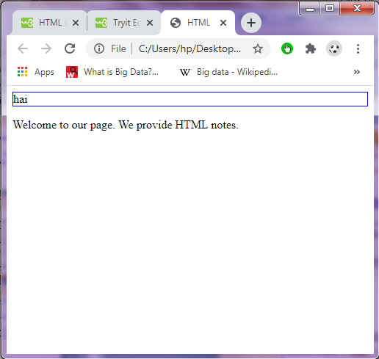
<div> Element
Output
<!DOCTYPE html>
<html>
<head> <title>HTML div Tag</title>
</head>
<body>
<div id="contentinfo" style="border:1px solid blue"> hai </div>
<p>Welcome to our page. We provide HTML notes.</p>
</body>
</html>

Slide 7
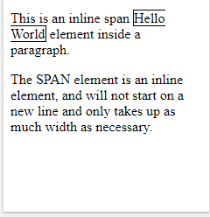
<span> Element
Output
<!DOCTYPE html>
<html>
<head> <title>HTML div Tag</title>
</head>
<body>
<div id="contentinfo“ style="border:1px solid pink"> hai </div>
<p>Welcome to our page. We provide HTML notes.</p>
</body>
</html>

Slide 8
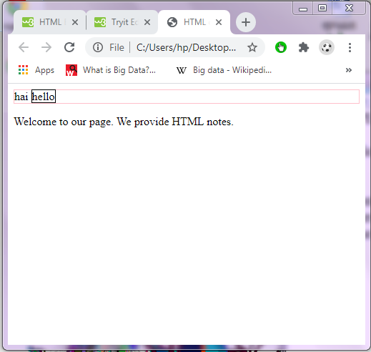
<div> & <span> Elements
Output
<!DOCTYPE html>
<html>
<head> <title>HTML div Tag</title>
</head>
<body>
<div id="contentinfo" style="border:1px solid pink"> hai
<span style="border: 1px solid black"> hello</span>
</div>
<p>Welcome to our page. We provide HTML notes.</p>
</body>
</html>

Slide 9
HTML Styles - Cascading Style Sheets (CSS)
CSS saves a lot of work. It can control the layout of multiple web pages all at once.
Cascading Style Sheets (CSS) is used to format the layout of a webpage.
With CSS, you can control the color, font, the size of text, the spacing between elements, how elements are positioned and laid out, what background images or background colors to be used, different displays for different devices and screen sizes, and much more!

Slide 10
Types
CSS can be added to HTML documents in 3 ways:
Inline - by using the style attribute inside HTML elements
Internal - by using a <style> element in the <head> section
External - by using a <link> element to link to an external CSS file
The most common way to add CSS, is to keep the styles in external CSS files.

Slide 11
Inline Style Sheet
An inline CSS is used to apply a unique style to a single HTML element.
An inline CSS uses the style attribute of an HTML element.
<html>
<head><title>INLINE STYLE SHEET</title>
</head>
<body>
<h5 style=“font:24pt Times new Roman bold”>
<center>Inline Style Sheet</center></h5>
<marquee style="background:blue;color:white;">Welcome to All</marquee>
<p align="center"><b>Definition:</b> Helps to add style information directly in a element</p>
<font>

Slide 12
Continued….
<p style="line-height:0.5in;text-indent:0.5;margin-left:1.5in;color:red;font-size:20pt">
This program is an example of internal style sheet which makes use of tags like style which overrides the styles of H1,strike,font tags
</p>
</font>
<strike style="color:blue">Internal Stylesheet</strike>
<hr width=50% noshade color="skyblue" >
</body>
</html>

Slide 13
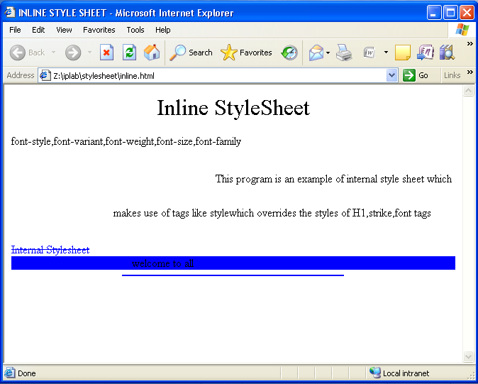
Output

Slide 14
Internal Style Sheet
<html>
<head>
<title>Styles</title>
<style type="text/css">
body
{
font-size:30pt;
font-family:monotype corsiva;
color:green;
background-color:yellow;
}
h1
{
font-size:30pt;
text-align:center;
color:red;
}

Slide 15
p
{
margin-left:50px;
margin-right:50px;
}
a:link {color:blue;}
a:visited {color:red;}
a:active {color:pink;}
</style>
</head>
<body>
<h1>Internal Style Example</h1><hr/><br/>
<p> Cascading Style sheets defined by <a href="sample.html"> Internal style</a> provides powerful page layout facilities
</p>
</body>
</html>

Slide 16
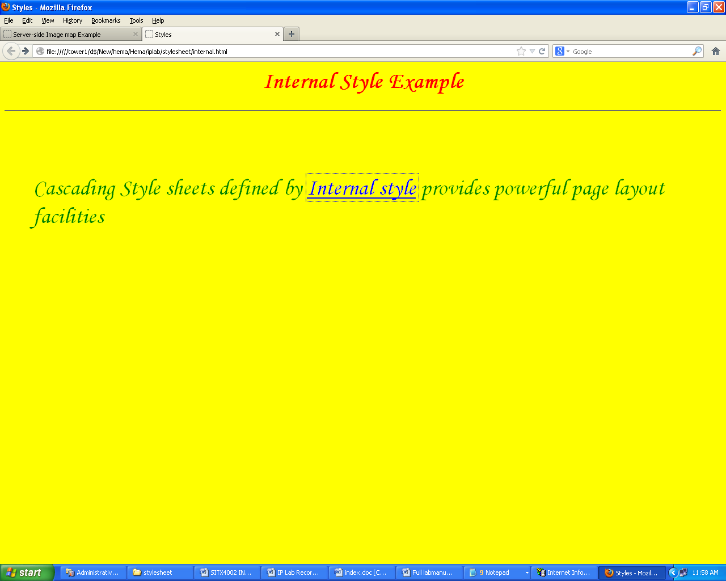
Output

